Slide 1
Important Dates
Assignment #1: Intro to Python – Opens 9/13
Research Proposal Instructions will be handed out. (9/13)
Assignment #2: Applying Analysis Techniques and Statistical Inference to Data: Opens 10/4
Assignment #1: Due 10/4
Students Research Proposals Due: (10/4)

Slide 2
Agenda
Guest Lecture: Vlad Barash from Graphika
Lecture 3: Data Munging
Lab:
Web Scraping
EDA
Go over Assignment 1.
Go Over Project Proposal Instructions.

Slide 3
So you want to be a data scientist…

Slide 4
How will you spend your time?

Slide 5
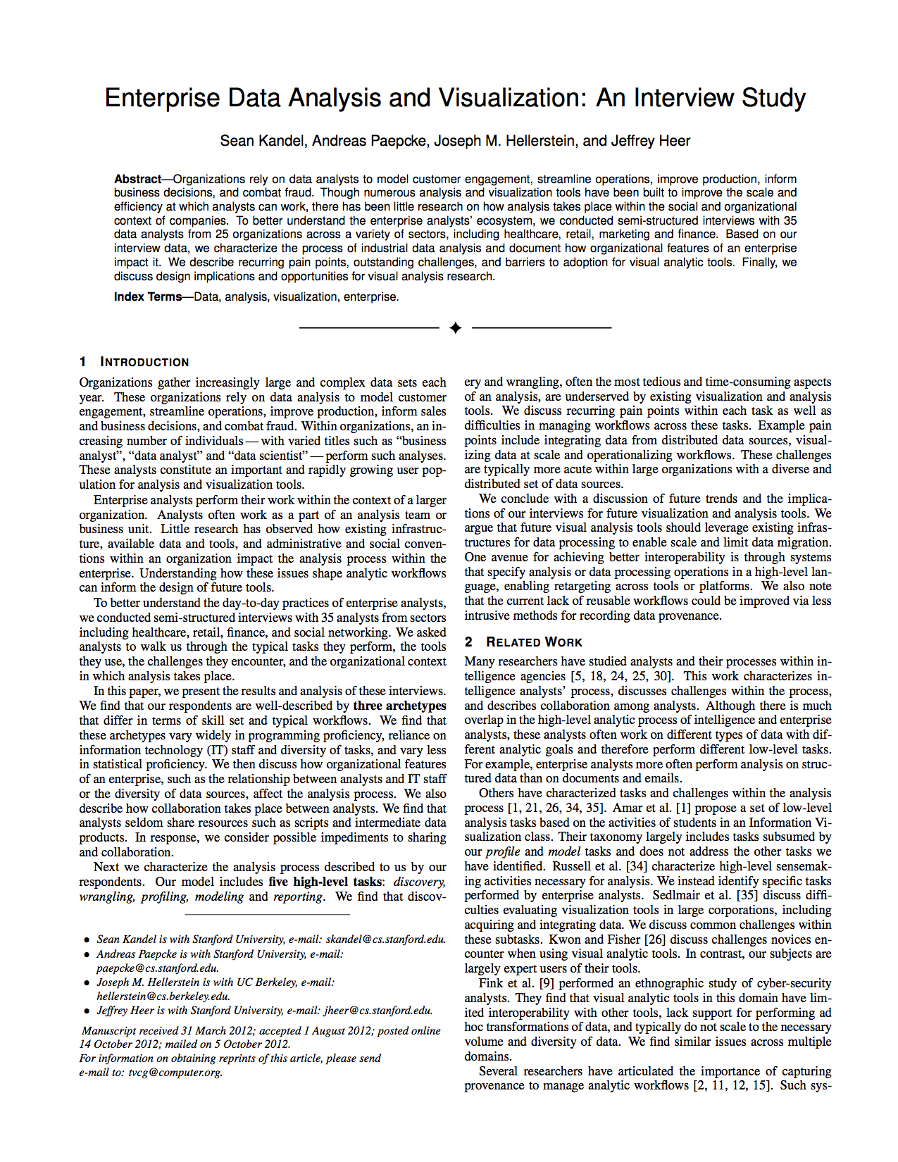
Enterprise Data Analysis and Visualization: An Interview Study
Interview study of 35 analysts
Various titles
Data analyst
Data scientist
Software engineer
Consultant
Chief technical officer
25 companies
Healthcare
Retail, Marketing
Social networking
Media
Finance, Insurance
Kandel et al. “Enterprise Data Analysis and Visualization: An Interview Study. IEEE Visual Analytics Science & Technology (VAST), 2012
http://db.cs.berkeley.edu/papers/vast12-interview.pdf
Notes:
----- Meeting Notes (10/29/14 17:37) -----
FINISH ME!

Slide 6
“I spend more than half of my time integrating, cleansing and transforming data without doing any actual analysis. Most of the time I’m lucky if I get to do any ‘analysis’ at all…
… Most of the time once you transform the data ... the insights can be scarily obvious.”

Slide 7
“Once you play with the data you realize you made an assumption that is completely wrong. It’s really useful, it’s not just a waste of time, even though you may be banging your head.”
“In practice it tends not to be just data prep, you are learning about the data at the same time, you are learning about what assumptions you can make.”

Slide 8

Data Wrangling
Aka Data Prep, Data Munging, Data Transformation
Assessing and transforming raw data to make it fit for use
That depends!
Fit for what use?

Slide 9
Data Wrangling
Aka Data Prep, Data Munging, Data Transformation
Assessing and transforming raw data to make it fit for use
This is how you “get your head in the game”
Understand what you have
Assess strengths and weaknesses of your data
Hypothesize about what to do with your data
Get it ready
Nobody will know your data as well as you do while wrangling
Not even the “you” of a few days later

Slide 10
Discussion
When is data “dirty”?
How does that happen?
Notes:
Many possibilities here for discussion
Outliers
Misspellings
Type/constraint violations
Inconsistencies
Duplication
Missing data
Unusual distributions
Wrong granularity
Wrong time or other scope
Data entry
Measurement error
Bad data integration
Poor experimental design
Mismatch of data to task

Slide 11
Today: Data Unboxing and Wrangling
Basic tools:
UNIX command line
SublimeText editor
Trifacta: a free visual data wrangling tool
Born at Berkeley/Stanford
Codifies some good practices you can also follow “by hand”
Later: Python’s Pandas library
You may choose to use other tools too
Good data scientists maintain a well-stocked toolbox

Slide 12
A bit of background before we jump in

Slide 13
Data Preparation overview
ETL
We need to extract data from the source(s)
We need to load data into the sink
We need to transform data at the source, sink, or in a staging area
Sources: file, database, event log, web site, HDFS…
Sinks: Python, R, SQLite, RDBMS, NoSQL store, files, HDFS…

Slide 14
Data Preparation overview
Process model
The construction of a new data preparation process is done in many phases
Data characterization
Data cleaning
Data integration
We must efficiently move data around in space and time
Data transfer
Data serialization and deserialization (for files or network)

Slide 15
Data Preparation overview
Workflow
The transformation pipeline or workflow often consists of many steps
For example: Unix pipes and filters
$ cat data_science.txt | wc | mail -s "word count” myname@some.com
If the workflow is to be used more than once, it can be scheduled
Scheduling can be time-based or event-based
Use publish-subscribe to register interest (e.g. Twitter feeds)
Recording the execution of a workflow is known as capturing lineage or provenance

Slide 16
The Businessperson
Data Sources
Web pages
Excel
ETL
Copy and paste
Data Warehouse
Excel
Business Intelligence and Analytics
Excel functions
Excel charts
Visual Basic?!

Slide 17
The Programmer
Data Sources
Web scraping, web services API
Excel spreadsheet exported as CSV
Database queries
ETL
wget, curl, Beautiful Soup, lxml
Data Warehouse
Flat files
Business Intelligence and Analytics
Numpy, Matplotlib, R, Matlab

Slide 18
The Enterprise
Data Sources
Application databases
Intranet files
Application server log files
ETL
Informatica, IBM DataStage, Ab Initio, Talend
Data Warehouse
Teradata, Oracle, IBM DB2, Microsoft SQL Server
Business Intelligence and Analytics
Business Objects, Cognos, Microstrategy
SAS, SPSS, R

Slide 19
The Web Company
Data Sources
Application databases
Logs from the services tier
Web crawl data
ETL
Flume, Sqoop, Pig, Crunch, Oozie
Data Warehouse
Hadoop/Hive, Spark/Shark
Business Intelligence and Analytics
Custom dashboards: Argus, BirdBrain
R

Slide 20
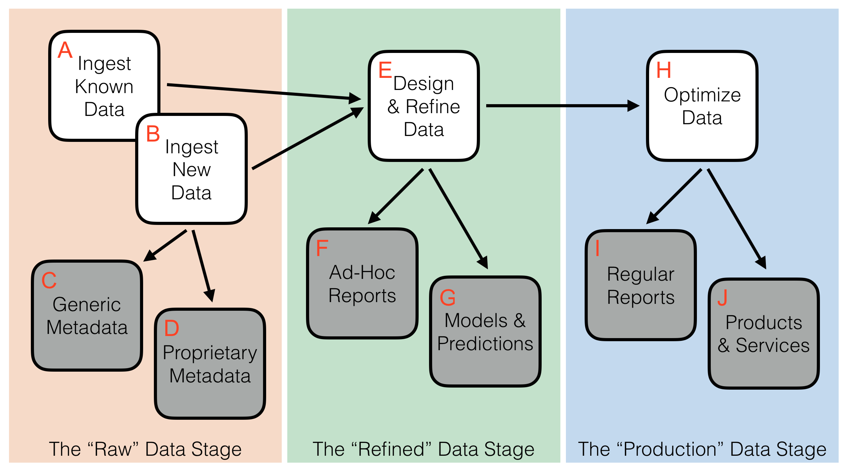
Stages of Wrangling
Raw: Data ingestion & discovery (“unboxing”)
What: Exploratory ad hoc analysis
Who: The individual wrangler
Refined: Curating data for reuse
What: Data warehousing, canonical models
Who: Data curators, IT engineers, actuaries, etc.
Production: Ensuring feeds and workflows
What: Recurrent, automated use cases:
Traditional (e.g. reporting) + New (e.g. recommenders)
Who: Often involves SW engineers and IT/ops folks
Rattenbury, et al. “Data Wrangling: Techniques and Concepts for Agile Analytics”. To appear, O’Reilly Media, 2017.

Slide 21
Today
We will focus on the “Raw➝Refined” stage
Unboxing
Transformation to analytics-ready structure
Assessment/mitigation of quality issues
This is just a taste
Soon you will learn to do this in Python & Pandas
More on this in future lectures!

Slide 22
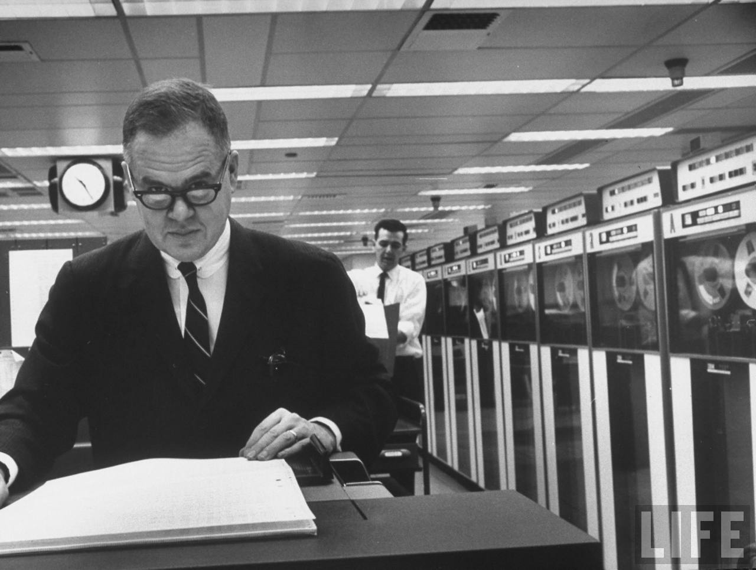
Data Analysis & Statistics, Tukey 1965
Notes:
John Tukey, Princeton mathematician and statistician, inventor of the Fast Fourier Transform and father of Exploratory Data Analysis. Also coined the word “bit”.
Emphasis courtesy Jeff Heer, U. Washington

Slide 23
Some implications for effective data analysis are: (1) that it is essential to have convenience of interaction of people and intermediate results and (2) that at all stages of data analysis, the nature and detail of output, both actual and potential, need to be matched to the capabilities of the people who use it and want it.

Slide 24
Some implications for effective data analysis are: (1) that it is essential to have convenience of interaction of people and intermediate results and (2) that at all stages of data analysis, the nature and detail of output, both actual and potential, need to be matched to the capabilities of the people who use it and want it.

Slide 25
Nothing - not the careful logic of mathematics, not statistical models and theories, not the awesome arithmetic power of modern computers - nothing can substitute here for the flexibility of the informed human mind.

Slide 26
Nothing - not the careful logic of mathematics, not statistical models and theories, not the awesome arithmetic power of modern computers - nothing can substitute here for the flexibility of the informed human mind.

Slide 27
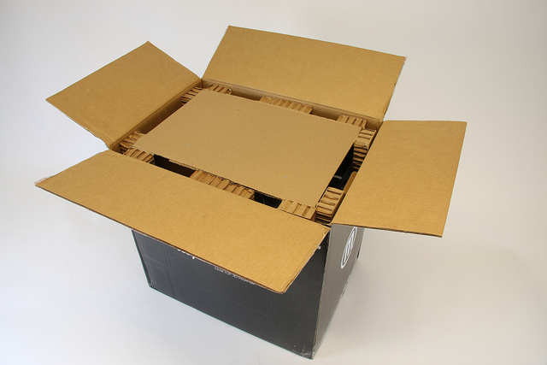
Unboxing Data
What do I have here?
What do I want to do with it?
These questions rarely have pat answers.
Typically contextual and user-driven
Typically subject to iterative cycles of wrangling and analysis

Slide 28
Rough Guide to Wrangling Issues an outline for today’s lecture
Structure: the “shape” of a data file
Granularity: how fine/coarse is each datum
Faithfulness: how well does the data capture “reality”
Temporality: how is the data situated in time
Scope: how (in)complete is the data
Many of these are subjective qualities! Depend on context.
(Data) Science is a human process.
Structure | Granularity | Faithfulness | Temporality | Scope

Slide 29
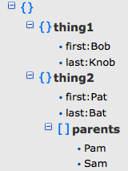
Structure: Rectangular Data
Natural for data analysis: easy to access, filter, tabulate
Two main variants
Relations (a.k.a. tables, data-frames)
Manipulate with Relational Algebra
Matrices
Manipulate with Linear Algebra
There are non-rectangular structures as well, e.g. JSON, XML. For analysis, you will typically need to convert these to rectangular structures.
Structure | Granularity | Faithfulness | Temporality | Scope

Slide 30
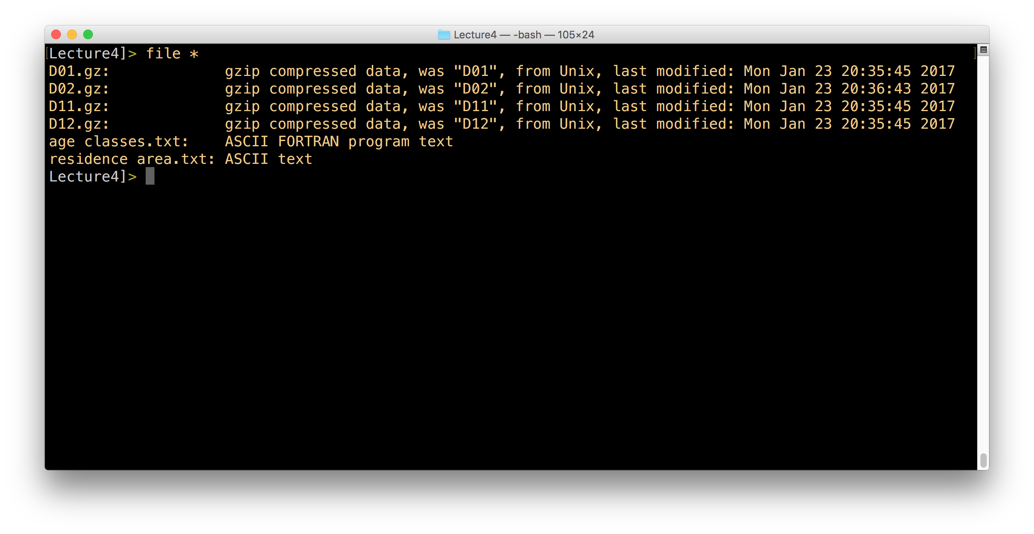
Unboxing with UNIX Command Line
File metadata
ls -lh
file
wc
File (de)compression
gunzip, zip, bzip, etc.
stdout and the pipe
File content:
cat
head
tail
less
<ctrl>-C
Structure | Granularity | Faithfulness | Temporality | Scope
Notes:
DEMO
ls -lh
file *
gunzip -c D01.gz | wc
gunzip -c D01.gz | head
gunzip -c D01.gz | tail
gunzip -c D01.gz | less
gunzip -c D*.gz | wc

Slide 31
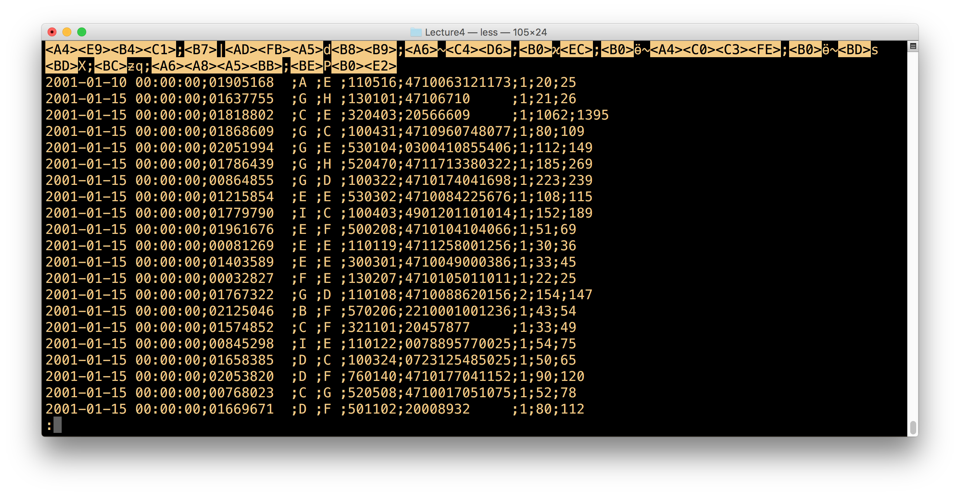
Structure Questions: A Checklist
Coarse structure
Is the data structured as a collection of records?
How are the individual records delimited in the dataset?
How are the record fields delimited from one another?
Do all records in the dataset contain the same fields?
How to access the same fields across records? By position? Name?
Are the records nested?
No: one atomic (singular) value per field
Yes: collection of 0-to-many values in a field
Encoding
How are values encoded? Strings? Codes? Binary?
How complex are the individual values?
Primitive: numbers and short strings?
Unstructured data: natural language text, audio, video
Can you decode?
Structure | Granularity | Faithfulness | Temporality | Scope

Slide 32
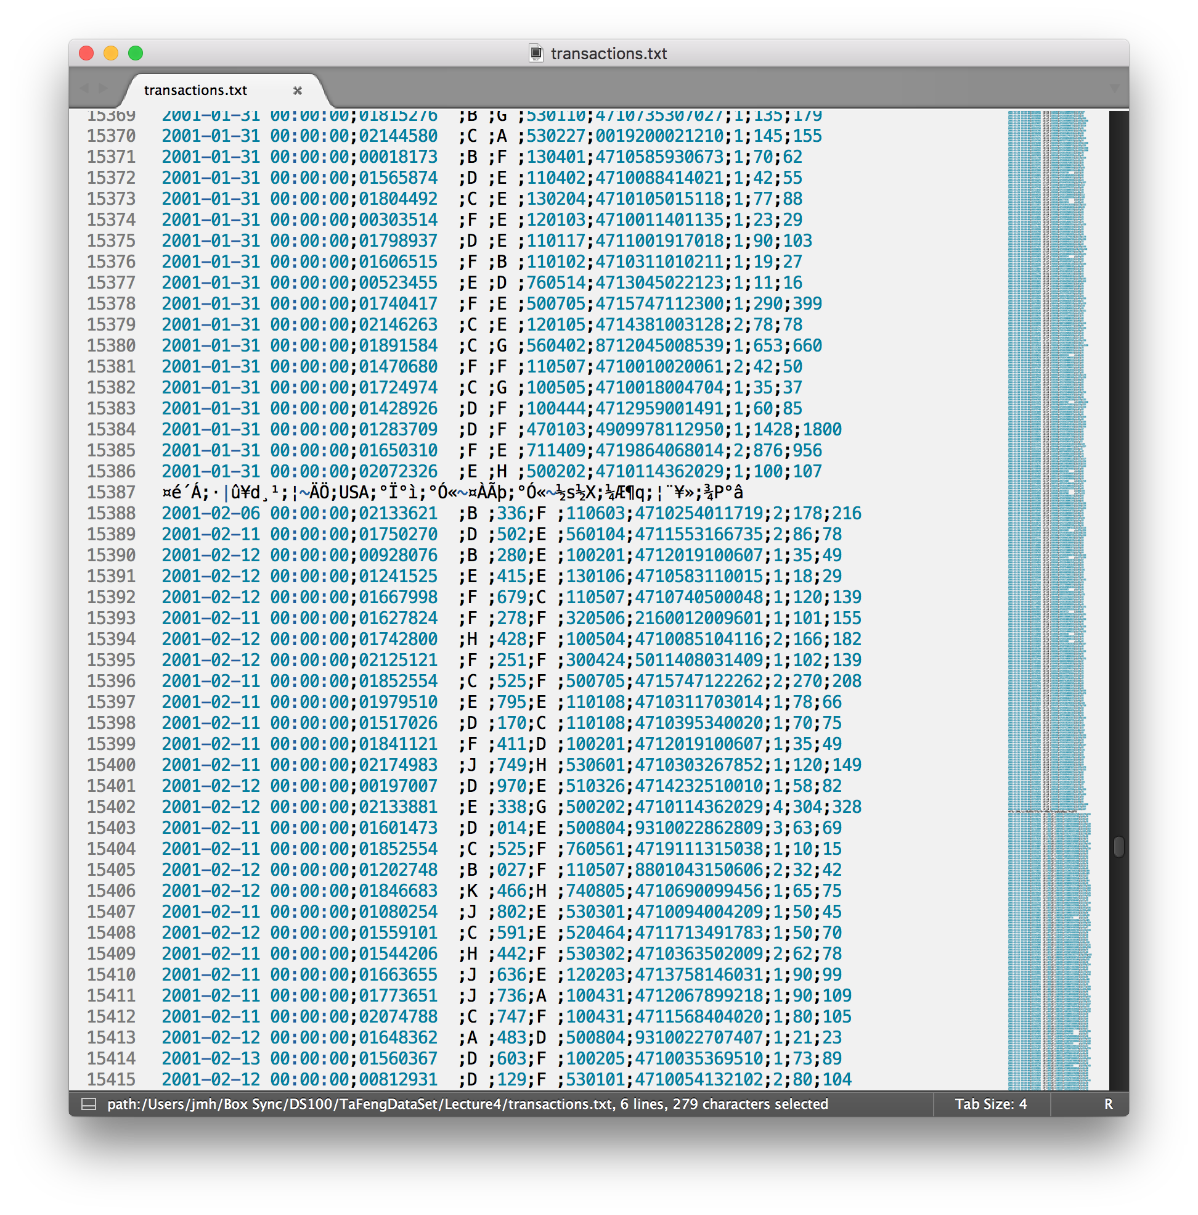
Modern Text Editor: SublimeText
Assessing
Coloring
Minimap
Transformation
Do not destroy!
Names/Versions?
More on this soon!
Structure | Granularity | Faithfulness | Temporality | Scope
Notes:
gunzip -c D11.gz D12.gz D01.gz D02.gz > TaFengTransactions.txt
open TaFengTransactions.txt -- widen out … not line 2170
delete row
But notice schema is non-uniform!
To save or not to save?
File naming? Yuck. Git.

Slide 33
Structure Questions: A Checklist
Coarse structure
Is the data structured as a collection of records?
How are the individual records delimited in the dataset?
How are the record fields delimited from one another?
Do all records in the dataset contain the same fields?
How to access the same fields across records? By position? Name?
Is the data nested?
No: one atomic (singular) value per field
Yes: collection of 0-to-many values in a field
Encoding
How are values encoded? Strings? Codes? Binary?
How complex are the individual values?
Primitive: numbers and short strings?
Unstructured data: natural language text, audio, video
Can you decode?
Structure | Granularity | Faithfulness | Temporality | Scope
Notes:
DEMO Here

Slide 34

Unboxing with Trifacta
Visual Profiling + Transformation
Iterative and ongoing
Predictive Interaction
Transformation language: Wrangle
Superset of relational algebra
Wrangle (and Pandas) both related to SQL
Generates a “recipe” (script)
You can run it on data to generate new data
Scale & Interoperability
Paid version works with “big data”
Spark/Hadoop
Some implications for effective data analysis are: (1) that it is essential to have convenience of interaction of people and intermediate results and (2) that at all stages of data analysis, the nature and detail of output, both actual and potential, need to be matched to the capabilities of the people who use it and want it.
Structure | Granularity | Faithfulness | Temporality | Scope

Slide 35
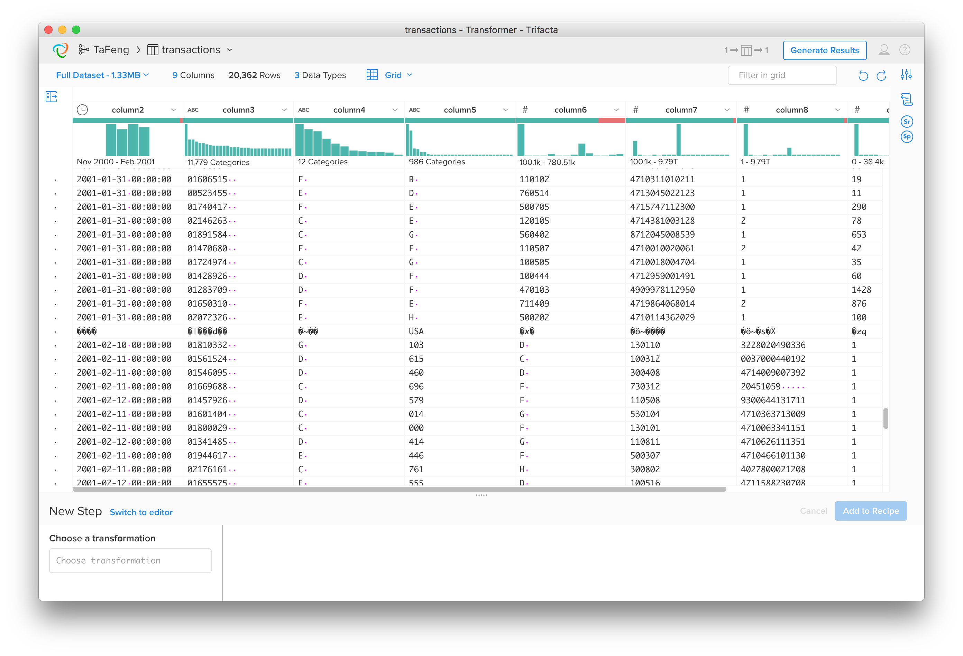
Structure Questions: A Checklist
Coarse structure
Is the data structured as a collection of records?
How are the individual records delimited in the dataset?
How are the record fields delimited from one another?
Do all records in the dataset contain the same fields?
How to access the same fields across records? By position? Name?
Is the data nested?
No: one atomic (singular) value per field
Yes: collection of 0-to-many values in a field
Encoding
How are values encoded? Strings? Codes? Binary?
How complex are the individual values?
Primitive: numbers and short strings?
Unstructured data: natural language text, audio, video
Can you decode?
Structure | Granularity | Faithfulness | Temporality | Scope
Notes:
DEMO HERE
// open age_classes
// note basic structure for free: row per code, multiple delimiter types
splitrows col: column1 on: '\n'
// split on space
split col: column1 on: `{delim}`
rename col: column2 to: 'code'
rename col: column3 to: 'age_range'
// extract the high side of the age range
extract col: age_range on: `{digit}+` after: `-` before: `{end}`
rename col: column1 to: 'max_age'
// extract the low side of the age range
extract col: age_range on: `{digit}+`
rename col: column1 to: 'min_age'
// compute the center of the range
derive value: ((max_age - min_age) / 2) + min_age as: 'column1'
// Note data quality bar!
settype col: column1 type: 'Float'
rename col: column1 to: 'center_age’
// clean residence area
// row per code
splitrows col: column1 on: '\n'
// split into code, zip
split col: column1 on: `{delim-ws}`
rename col: column2 to: 'code'
rename col: column3 to: 'zip'
// convert to string
settype col: zip type: 'String'
// OPEN transactions.txt
// Row per transaction
// Splitrow on '\r\n'
splitrows col: column1 on: '\r\n'
// Deal with the shifted columns
replace col: column1 with: '$1;;$2' on: `({digit}{8} ;{upper}) ;({upper})` global: true
// Can split on ';'
split col: column1 on: ';' limit: 9
// trim space
replace col: * with: '' on: ` *` global: true before: `{end}`
// Headers in Chinese -- drop and manually convert to English
delete row: ismismatched(column7, ['Integer'])
// OPEN english headers
// add in oddball column after age_code
splitrows col: column1 on: '\n' // Deal with the shifted columns
replace col: column1 with: 'age_code;unknown;' on: 'age_code;'
// split on ;
split col: column1 on: ';' limit: 9
// UNION in transactions.txt
union with: transactions mapping: {'as': 'column2', 'sources': current_dataset.column2,transactions.column2}, {'as': 'column3', 'sources': current_dataset.column3,transactions.column3}, {'as': 'column4', 'sources': current_dataset.column4,transactions.column4}, {'as': 'column5', 'sources': current_dataset.column5,transactions.column5}, {'as': 'column6', 'sources': current_dataset.column6,transactions.column6}, {'as': 'column7', 'sources': current_dataset.column7,transactions.column7}, {'as': 'column8', 'sources': current_dataset.column8,transactions.column8}, {'as': 'column9', 'sources': current_dataset.column9,transactions.column9}, {'as': 'column10', 'sources': current_dataset.column10,transactions.column10}, {'as': 'column11', 'sources': current_dataset.column11,transactions.column11}
header

Slide 36
So Far: Assessing Structure
Basic tools
UNIX commands
Text editors
Simple data transformation
Edit-in-place, character-by-character or Find/Replace
Save versions of files
Scripted transformations
Save scripts, inputs, outputs
Structure | Granularity | Faithfulness | Temporality | Scope

Slide 37
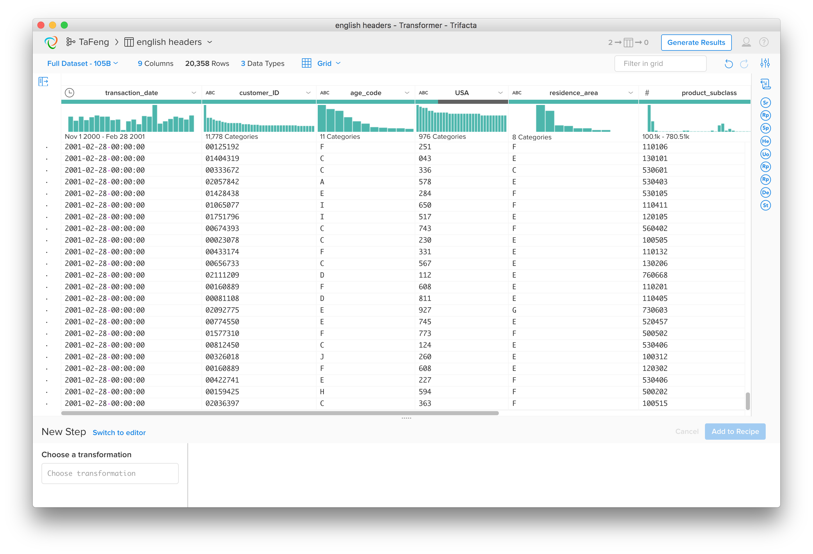
Value Encodings: Primitive Types
Numbers and Strings
We’ll spend time here today
Common special-case “primitives”
Date/Time
Geolocations
Space and time can be surprisingly subtle/messy!
Structure | Granularity | Faithfulness | Temporality | Scope
Notes:
// ASSESS DATA TYPES
// NUMERIC vs. CATEGORICAL
// customer_id: a number or what?
// convert to Integer
settype col: customer_ID type: 'Integer'
// SPECIAL TYPES: datetime
- Transaction dates look fishy?
- Extract Times are bad: Split out dates from times.
split col: transaction_date on: ` `

Slide 38
Primitive Type Semantics
Categorical #1: Nominal
E.g. political party affiliation
Note: Sometimes even numeric data is nominal
Categorical #2: Ordinal
E.g. education level (none, HS, College, Post-College)
Ordered, but not particularly quantitative
Quantitative: amounts, measures
Negative or positive
Arithmetic “makes sense” (e.g. difference, ratio)
Integers vs. Rational numbers
Who cares?
Affects how you interpret the data
E.g. In visualization or summarization
Structure | Granularity | Faithfulness | Temporality | Scope
Notes:
ASSESS DATA TYPES!!
NUMERIC vs. CATEGORICAL
customer_id: a number or what?
String: Most popular customer?
Number: we have an outlier.
Column Details
What if we delete it! Nice… but let’s put it back for now
SPECIAL TYPES: datetime
Pick types for all the Ta Feng columns

Slide 39
In Sum: Tools and Structure
Coarse structure
Identifying data “shape”, records/fields and delimiters
Value encodings
Categorical, Ordinal, Quantitative
Basic tools
UNIX commands
Text editors
Simple data transformation
Edit-in-place, character-by-character or Find/Replace
Scripted transformations
Structure | Granularity | Faithfulness | Temporality | Scope

Slide 40
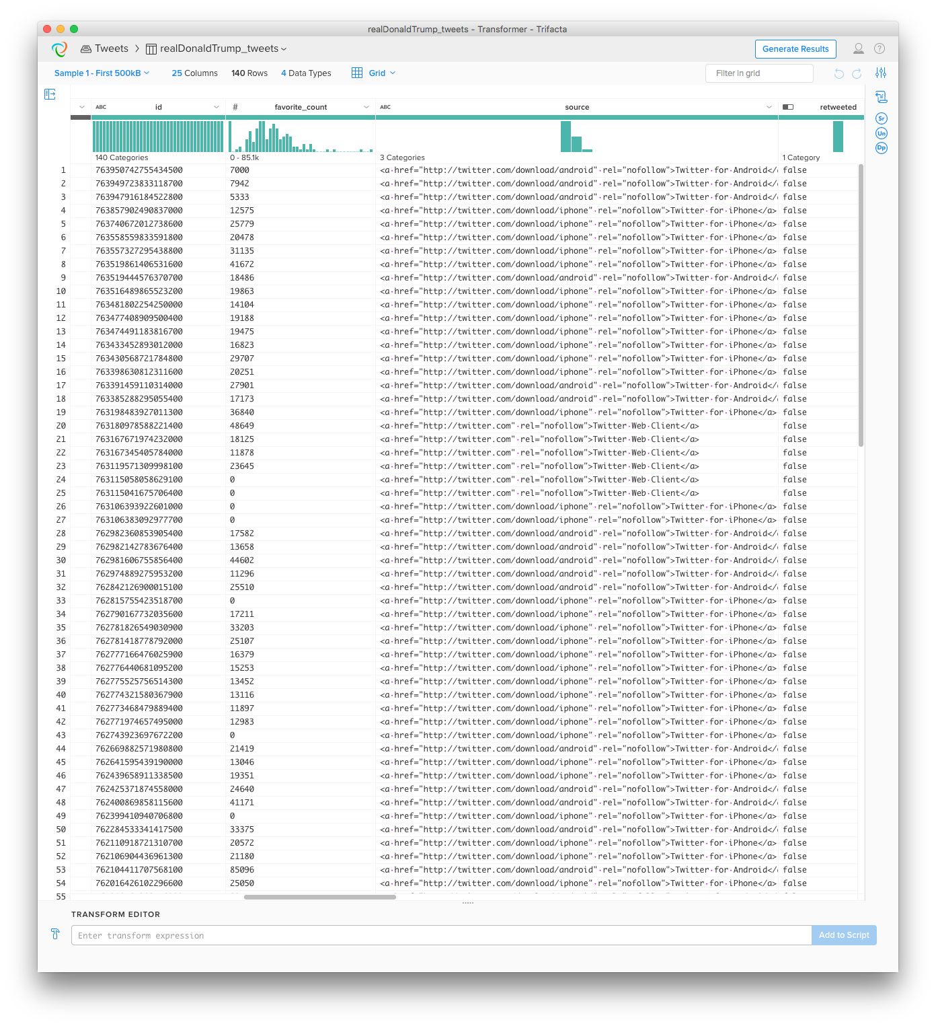
Assessing Granularity
What is the granularity of each record in this data set?
Structure | Granularity | Faithfulness | Temporality | Scope

Slide 41
What does each TaFeng record represent?
Theories?
Justification?
Structure | Granularity | Faithfulness | Temporality | Scope
Notes:
Theory on what each record in the TaFeng data represents?
How do you justify your theory?

Slide 42
Assessing Granularity
What is the granularity of each record in this data set?
What is the key of the data set?
Structure | Granularity | Faithfulness | Temporality | Scope

Slide 43
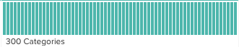
Key (“primary key”)
Given a relation, a key attribute uniquely determines the values in each record
E.g. an identifier like transaction_id
Can be composite: e.g. (City, State)
Each value occurs at most once in the key column(s).
Hence the semantics (meaning) of the key determines granularity
customer_id? transaction_time?
(age_code, day_of_week)
Be careful!
Goofy key choice? Goofy data.
Real-world data may have “noisy”, duplicated keys to clean up
Structure | Granularity | Faithfulness | Temporality | Scope
Notes:
Read this as “information we have per key”

Slide 45
Joining tables with keys
Keys in our data
age classes.txt: code
residence area.txt: code
transactions.txt: transaction_id
Transactions.txt also has foreign keys
i.e. attributes that reference the key of another table
age_code is a foreign key to age classes.txt
residence_area is a foreign key to residence area.txt
Joining on a foreign key is a “lookup”
At most one match for each row of TaFengTransactions.txt
More on this in future lectures!
Structure | Granularity | Faithfulness | Temporality | Scope
Notes:
Join in the age codes (leave residence area for later)

Slide 46
Granularity Questions: a Checklist
What kind of thing does each record represent?
Do all records capture granularity at the same level?
What alternative interpretations of the records are there?
E.g. Is this a list of transactions? Or a list of customers?
What kinds of aggregation is possible/desirable?
From individual people to demographic groups?
From individual events to totals across time or regions?
Hierarchies (city/county/state, second/minute/hour/day)
Structure | Granularity | Faithfulness | Temporality | Scope

Slide 47
So Far: Assessing Granularity
Identifying (primary) keys can help assess Granularity
Each record is the information per key
Foreign Keys are pointers to individual rows in other data sets
To lookup a row in another table: join the foreign key to its primary key
Structure | Granularity | Faithfulness | Temporality | Scope

Slide 48
Assessing Faithfulness
Theme: the Faithfulness of a record can only be evaluated in context
Application context
Context in your data set
Across records
Students
id: integer | DOB: date | GPA: float
123457 | 01/16/1997 | 3.2
123458 | 01/24/2017 | 2.7
123457 | 01/16/2002 | 5.0
Students
id: integer | DOB: date | GPA: float | Risk: float
123457 | 01/16/1997 | 3.2 | 465
123458 | 01/24/2017 | 2.7 | 28
123457 | 01/16/2002 | 5.0 | 27
123459 | 03/22/1996 | 3.6 | 31
123460 | 06/13/1997 | 2.2 | 43
Structure | Granularity | Faithfulness | Temporality | Scope

Slide 49
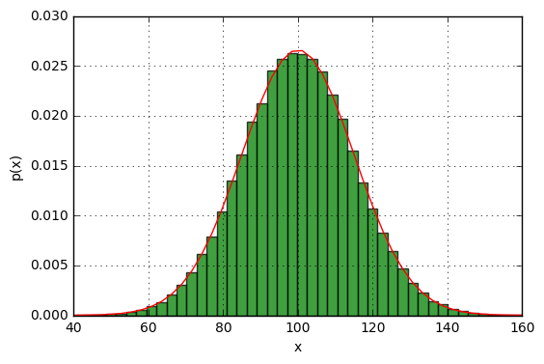
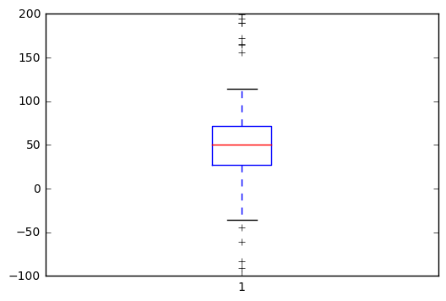
Faithfulness Across Records: Outliers
What is an “outlier”?
A value that is “far” from the “center”
Distribution-based definition
Center (e.g. average, median)
Spread (e.g. standard deviation, IQR)
More on this in future lectures!
Structure | Granularity | Faithfulness | Temporality | Scope

Slide 50

What to do with Outliers?
❌
Delete. (“trimming”)
Set to a default
E.g. the nearest non-outlier (“Winsorizing”)
Good Hygiene:
Leave the original column
Derive an indicator column to flag presence of outlier
Derive a clean column for your use
Structure | Granularity | Faithfulness | Temporality | Scope

Slide 51
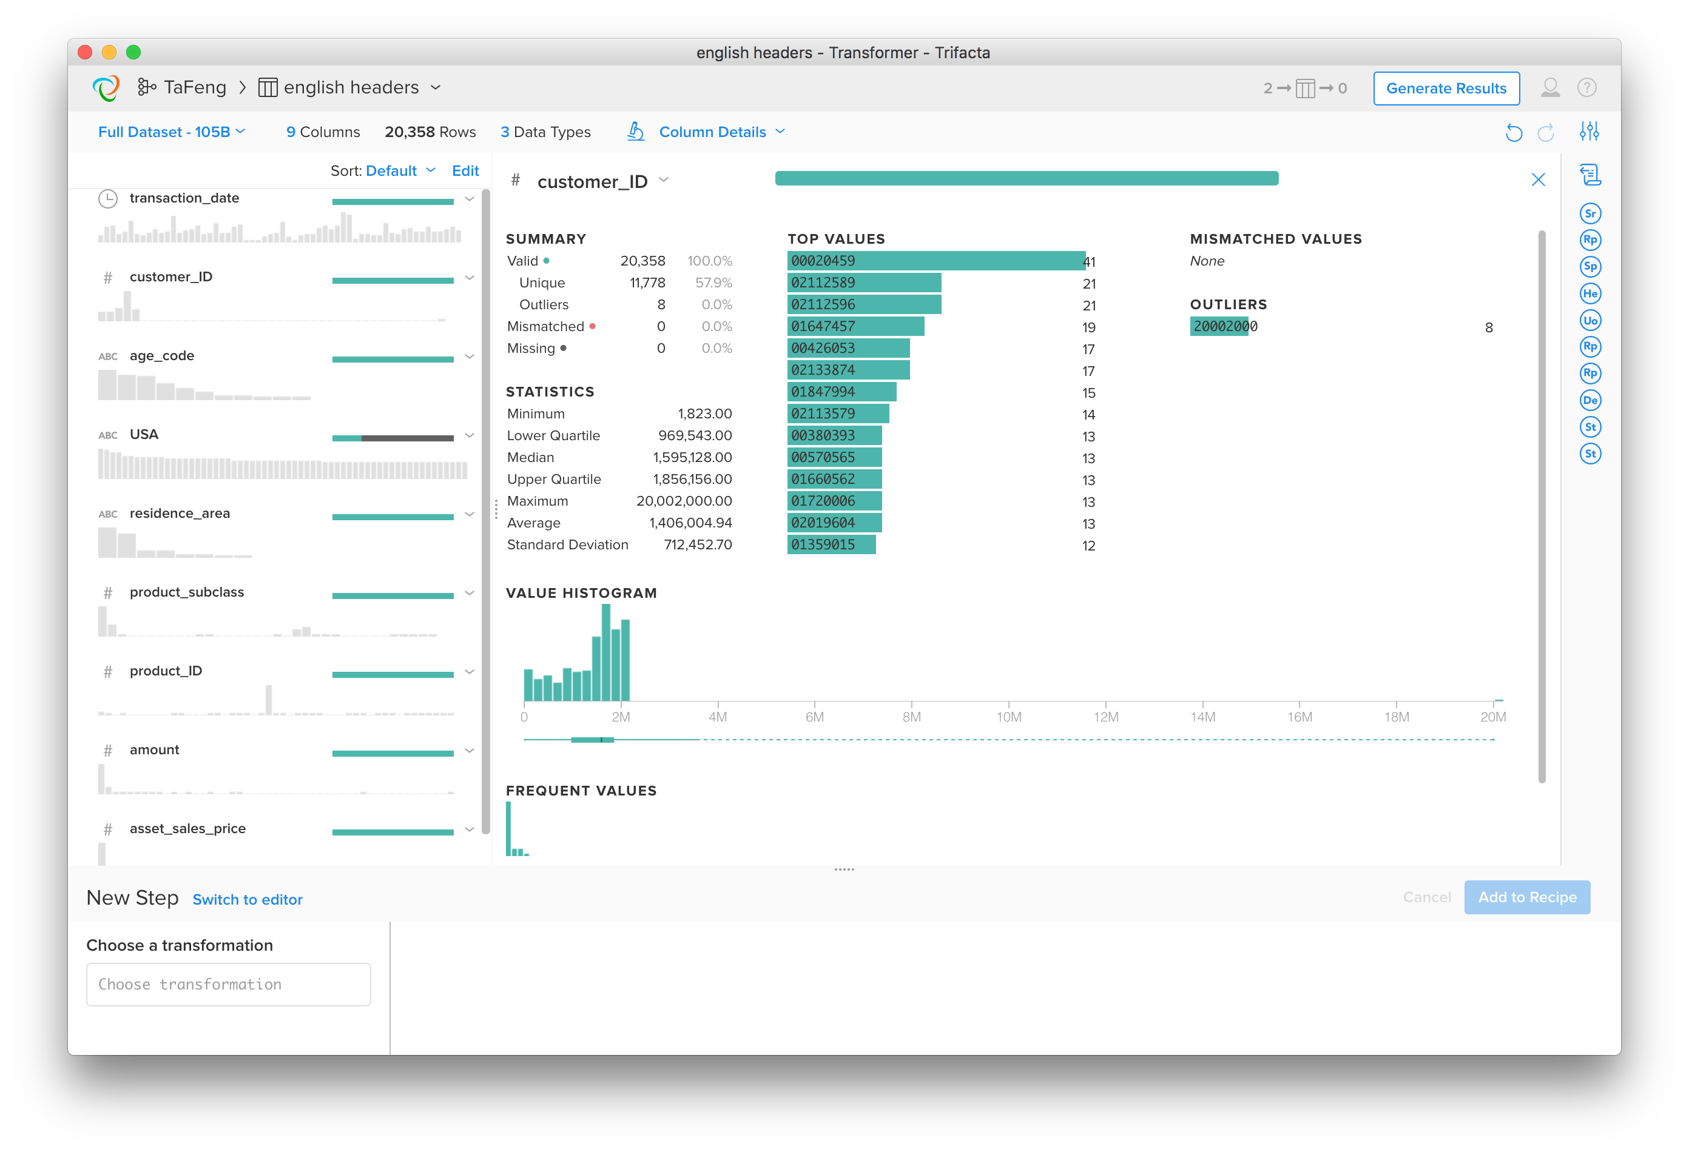
Notes:
Go back to customer_ID
// Let's clean up that weird customer_ID
// derive an outlier indicator column
derive value: customer_ID == '20002000' as: 'customer_ID_outlier'
// derive a copy of the column
derive value: customer_ID as: 'customer_ID_clean'
// set the outlier to NULL
set col: customer_ID_clean value: null() row: 20000000 <= customer_ID_clean
// coerce type back to Integer
settype col: customer_ID_clean type: 'Integer'

Slide 52
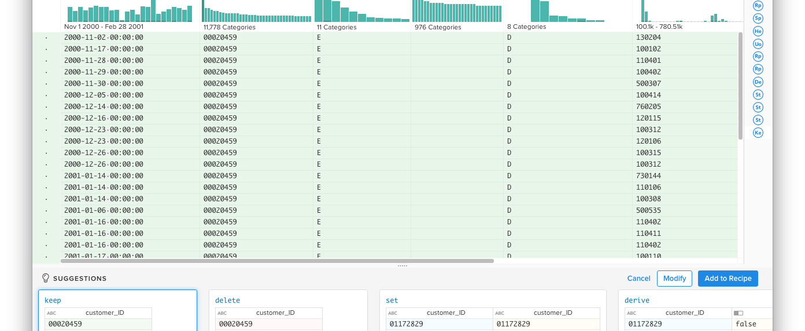
Assessing Faithfulness Within Records: Dependencies and Correlations
Structure | Granularity | Faithfulness | Temporality | Scope
Notes:
customer_id FDs
click on most popular customer
age code and residence area seem to be functions of customer_id (makes sense!)
Product subclass: integer type?
Or string type? Ordinal? Categorical?
Convert to string type
Check sales_price: non-uniform. Makes sense.
Product_id and FDs:
convert to string
click on most popular item
Single Product subclass? Yes.
Single price? No… but.... ?!?! Come back to this.

Slide 53
Functional Dependencies (FDs)
More on this in future!
Generalization of Keys
Attribute A determines Attribute B
customer_id -> age_code
i.e. age_code = f(customer_id)
Function represented as lookup table
More generally, a set of columns determines another set of columns
{transaction_time,customer_id} -> {age_code, residence_area}
Primary Keys are special FDs
Right-hand-size is the set of all attributes in the relation
Structure | Granularity | Faithfulness | Temporality | Scope
Notes:
Product_id and correlations
click on most popular item
Single sales_price? No!
Looks like sales_price is already multiplied by amount!!
Hypothesis: A linear correlation
derive value: sales_price / amount as: 'unit_price’
Check if product_id -> unit_price
aggregate value: count(),stdev(unit_price),stdev(sales_price) group: product_id
Hmmm... UNCLEAR IF WE CAN TRUST THIS!! We should compute some stats here!

Slide 54
Correlations
More on this in future!
Dependence (i.e. lack of independence!) between 2 random variables
Think of the attributes in a relational schema
An instance of that relation was generated from some real-world process
Each column of that relation is a “random variable” generated by the process
A Functional Dependency is a “deterministic” correlation
Correlations are more general: statistical relationships
amount and sales_price are correlated
Structure | Granularity | Faithfulness | Temporality | Scope

Slide 55
What to do about bad FDs/Correlations
Cleaning Noisy FDs: customer_id -> age_code (kinda)
For a few customer IDs, there are multiple values of age_code
Set offending right-hand-side values to all match
Set offending left-hand-side values to NULL
Cleaning Correlations: height correlated with weight
Some rows don’t seem to follow the correlation (how do we decide?)
Can impute a likely value for one side or the other
Can set one side or the other to NULL
Don’t forget Good Hygiene!
Leave the original column
Derive new columns (indicators and/or cleaned data)
Careful! More on this in future.
Structure | Granularity | Faithfulness | Temporality | Scope
Notes:
FD example: derive value:max(unit_price) group:product_id
Correlation example:
flag rows that are more than 1 stdev from mean of group
derive value:unit_price < average(unit_price) - stdev(unit_price) || unit_price > average(unit_price) + stdev(unit_price) group:product_id as:'outlier'

Slide 56
Faithfulness Questions: A Checklist
Type-specific Faithfulness checks
Are dates and addresses legal/reasonable?
Numeric codes legal?: E.g. phone numbers, credit cards, social-security numbers etc.
Can you validate network endpoints? Email addresses, IP addresses, social network names
Need to deduplicate named entities: misspellings, acronyms (UCB vs Berkeley)
Checks for data entry problems
Frequency outliers for common default entry values (00000, 1234567)
Misspellings (compare to dictionaries)
Sensor drift – often timeseries-based
“Curbstoning” in surveys
Quantitative dirty data
Outliers, FDs, Correlations
Check distribution of inaccuracies
Do inaccuracies seem to affect a large fraction of records?
Are they concentrated in a particular subset of records?
Tricky!
Structure | Granularity | Faithfulness | Temporality | Scope

Slide 57
Summing Up: Faithfulness
Outliers
Functional Dependencies & Correlations
Good Data Cleaning Hygiene
Don’t overwrite: use indicators and derived columns
Structure | Granularity | Faithfulness | Temporality | Scope

Slide 58
Granularity Transformations
We can coarsen the granularity by picking new keys and “rolling up”
GroupBy and Aggregation
GroupBy
Choose a new primary key (the group-by columns)
Result will have one row per distinct values of this primary key
Aggregation
Summary (rollup) results per group
E.g. count(), or aggregation functions on attributes (sum(x), average(x), stdev(x) etc.)
Structure | Granularity | Faithfulness | Temporality | Scope
Notes:
GRANULARITY QUESTIONS
e.g. to assess age demographics, group per age
correlation between age and total volume of purchases per customer
e.g. to assess geo demographics, group per area
e.g. to assess both, group per customer and area

Slide 59
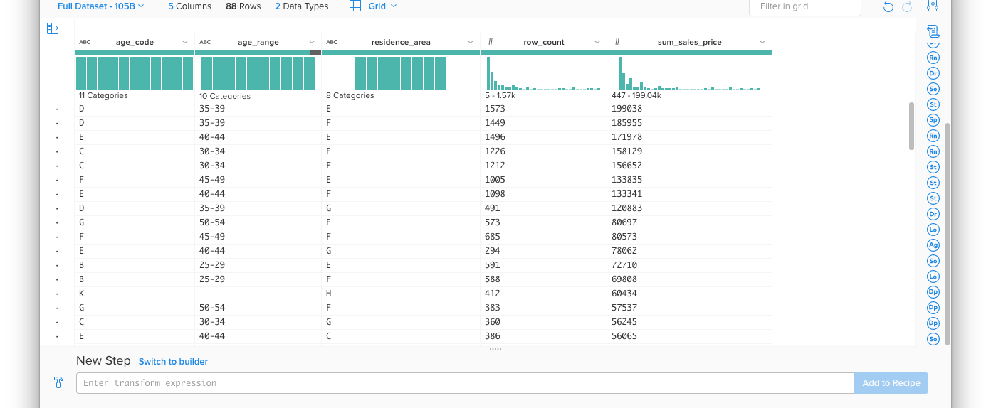
Finalizing Ta Feng
Notes:
Join back in the ages and sort by descending volume

Slide 60
What About Non-Rectangular Data
Nested Data
Free Text (i.e. for humans)
Example that has both: Twitter feed
Structure | Granularity | Faithfulness | Temporality | Scope
Notes:
EXTRACTING STRUCTURE: NESTED DATA AND STRINGS

Slide 61
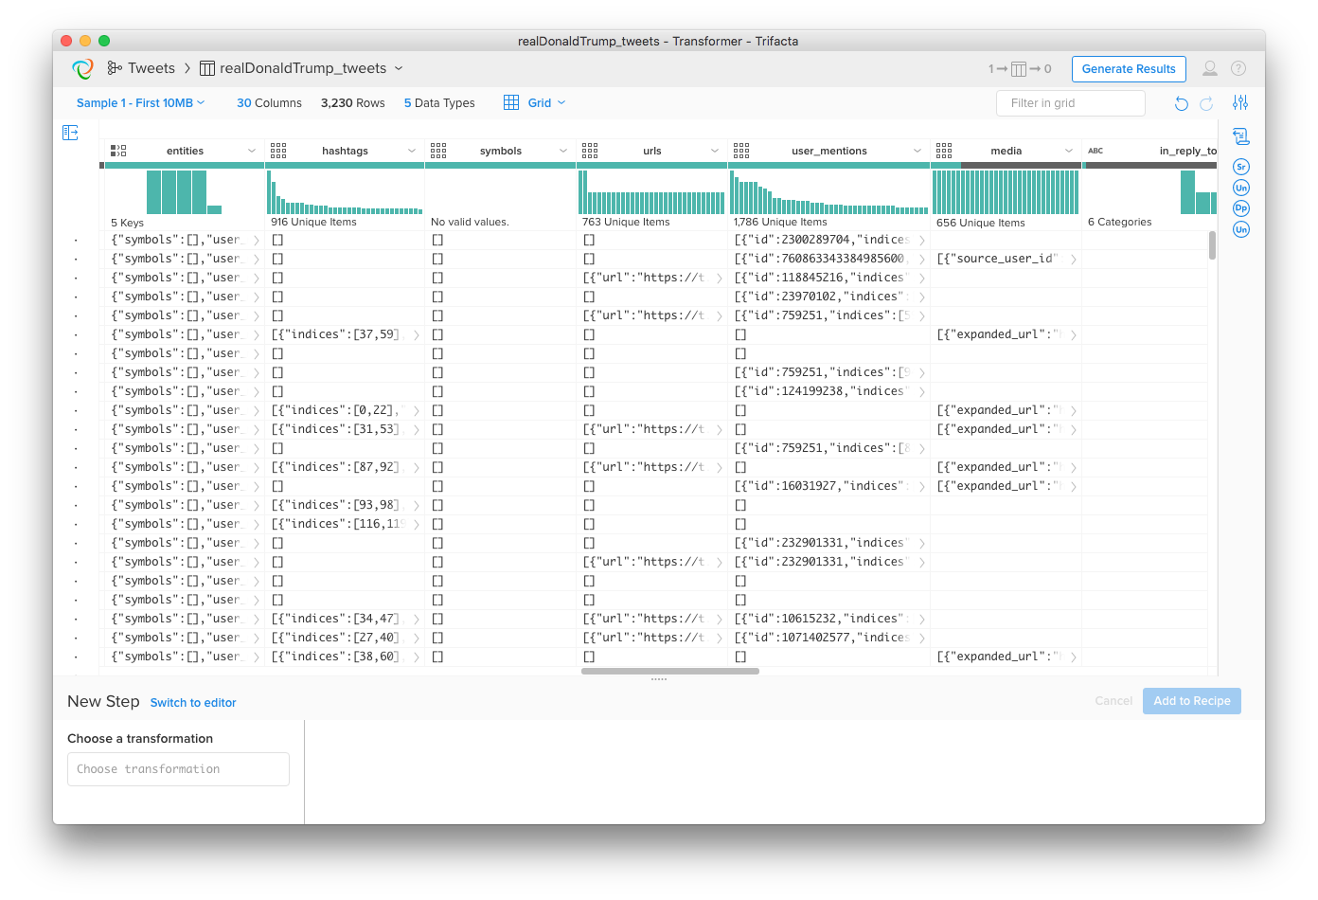
Unnesting Nested Data Types
More on this in future lectures!
Maps
A.k.a. dictionaries, hashes
A set of key:val pairs
Arrays
Or lists
Structure | Granularity | Faithfulness | Temporality | Scope
Notes:
EXTRACTING STRUCTURE: NESTED DATA AND STRINGS
unnest col: user keys: 'location','name’
unnest col: entities keys: 'hashtags’

Slide 62
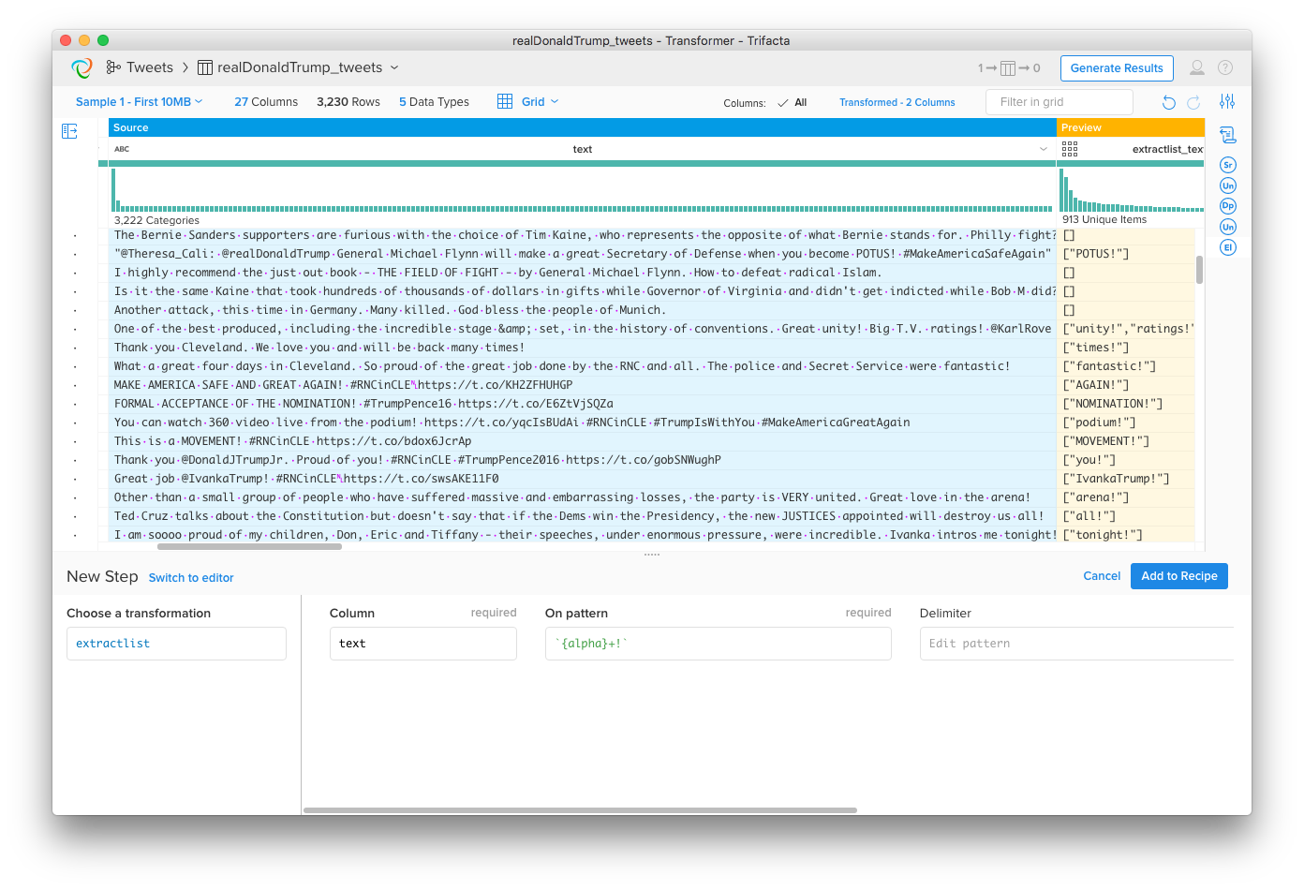
Playing with Text I: String Manipulation
More on this in future lectures!
Regular expression
(regex) extraction
Structure | Granularity | Faithfulness | Temporality | Scope
Notes:
REGEX
extractlist extractlist col: text on: `{alpha}+!` as: 'extractlist_text’

Slide 63
Playing with Text II: Natural Language
Natural Language Processing: a slippery slope
Entity Resolution
IBM vs. International Business machines
Named Entity Recognition
Steve Jobs munched on an apple as he announced new jobs at Apple.
Sentiment
My windows box crashed yet again.
Etc. Etc.
Hot topic today: Dialog systems:
Alexa, where did I leave my keys?
I don’t know. It’s a pity you don’t have a tracker on your key fob.
A what?
A bluetooth tracker – there are variety of them for sale
Stop trying to get me to buy stuff!
Sorry about that; I know you’ve been trying to save this month...
…but if you had one I could locate your keys.
Structure | Granularity | Faithfulness | Temporality | Scope
Notes:
EXTRACTING STRUCTURE: NESTED DATA AND STRINGS
XXX Term frequency via split/unnest
XXX Sentiment
- mixed-representation of place names?

Slide 64
Playing with Text II: Natural Language
Some simple things
Term frequencies
Simple Sentiment analysis
Structure | Granularity | Faithfulness | Temporality | Scope
Notes:
extractlist col: text on: `{any}+` delimiter: `{delim}` as: 'extractlist_text’
flatten col: extractlist_text
aggregate value: count() group: extractlist_text
sort order: -row_count

Slide 65
Quick Note: Assessing Temporality
Often two kinds of time in data
Time of data entry
Time of a recorded phenomenon being “true”
E.g. A physical time of an event happening
E.g. An “effective” time, e.g. date that a subscription will start
Often more
Time is tricky!
Periodicities (recurring patterns in Days of the week, or Months of the year)
Non-uniform hierarchy of units (# days in a month, # of days in a year, etc.)
Time zones are complex: especially daylight savings (summer) time
Clocks can be skewed
Relativity: true perception of event may vary (yep!)
Assess timestamps in data carefully!!
Structure | Granularity | Faithfulness | Temporality | Scope
Notes:
Revisit time column in Ta Feng … periodicities

Slide 66
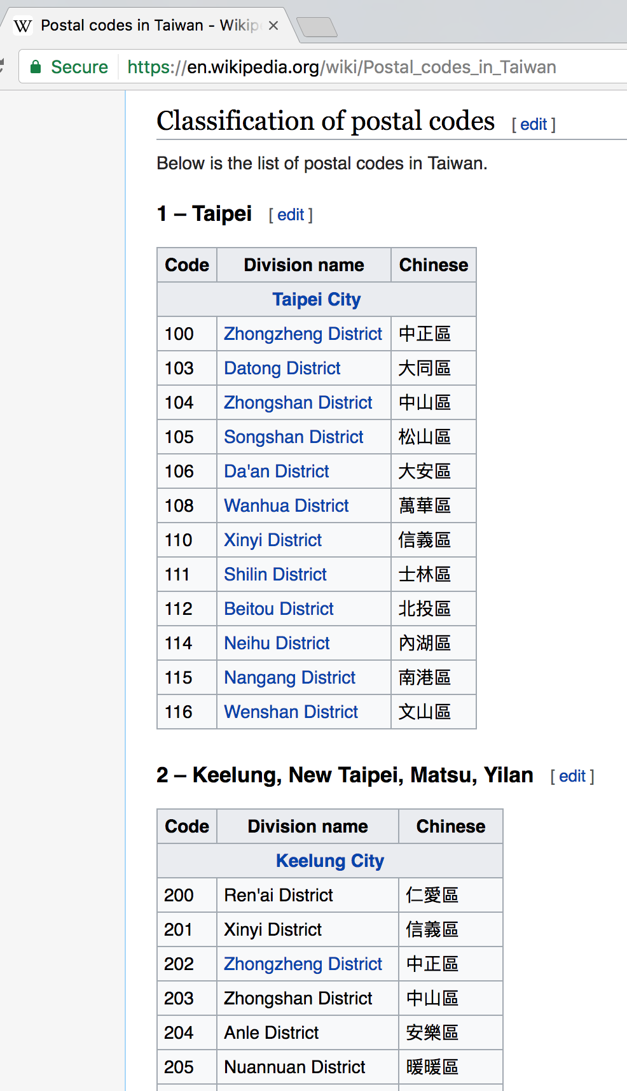
Quick Note: Assessing Scope
Do you have all the data you need
Missing columns
Join in external data
Missing rows/values?
Look for sequential patterns with breaks
Is this a good sample?
Granularity
Extent
How to impute reasonable stand-in values
Can be quite application specific/subjective!
More on this in future lectures!
Structure | Granularity | Faithfulness | Temporality | Scope
Notes:
missing columns: joins/lookups
Codes -- see distribution of residence codes
- JOIN IT IN
missing rows?
we know we're missing dates. Could we be missing other stuff?
MISSING RESIDENCE AREA CODES?

Slide 67
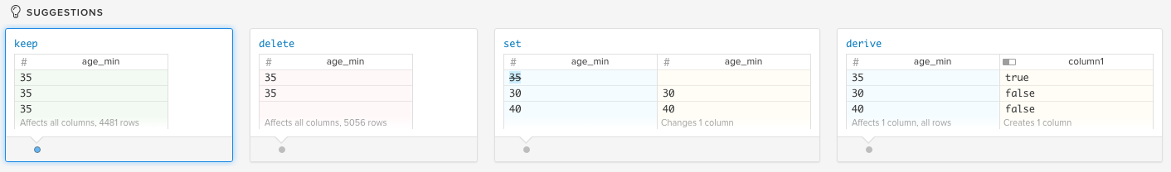
Looking Back: Data Transformations
Modifying structure
Splitting rows and columns (“splitrows”, “split”)
Unnesting (“flatten”)
Hiding Things
Rows (“keep”, “delete” a.k.a. “select”)
Columns (“drop”, “aggregate”)
Adding Things
“derive” a.k.a. “map”, “apply”
Changing Things
“replace”/”set”
Text manipulation
“extract”, “replace”, “set”
GroupBy/Aggregate arithmetic
“aggregate”, a.k.a. “group by”, “reduce”
Multi-table Operations
“join”, “lookup”
“union”

Slide 68
Looking Back: Bigger Picture
What decisions did we make along the way?
Data that got hidden
Choice of columns to drop
Values we cleaned: indicators, cleaned columns
Filtering of rows (vs. indicators)
Data that got added
Other derived columns: calculations, splits, extractions
Joins, Unions
Changes in granularity:
Coarser: grouping keys and aggregates
Finer: unnesting
How might the data wrangling influence the analyses we can do?
Sometimes we won’t figure this out until analysis begins
And we loop back to wrangling!

Slide 69
Impediments to Collaboration
Diversity of tools and PLs makes it hard to share
Finding a script or computed result is harder than just writing the program from scratch!
Q: How could we fix this?
View that much of the analysis work is “throw away”

Slide 70
Data Sources at Web Companies
Examples from Facebook
Application databases
Web server logs
Event logs
API server logs
Ad server logs
Search server logs
Advertisement landing page content
Wikipedia
Images and video

Slide 71
Tabular Data
What is a table?
A table is a collection of rows and columns
Each row has an index
Each column has a name
A cell is specified by an (index, name) pair
A cell may or may not have a value

Slide 72
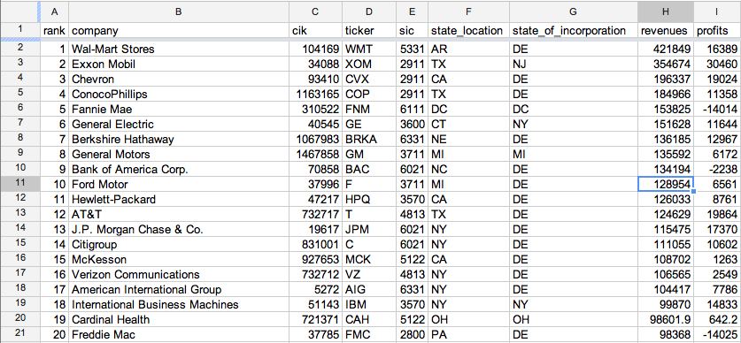
Tabular Data
Fortune 500

Slide 73
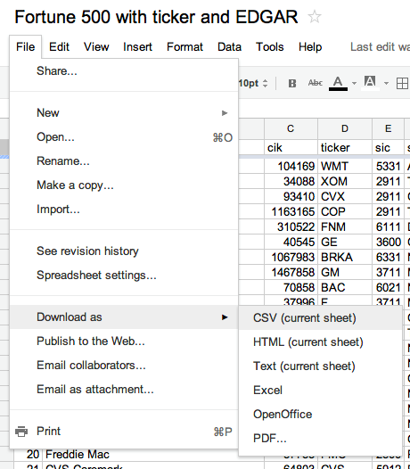
Tabular Data
Fortune 500

Slide 74
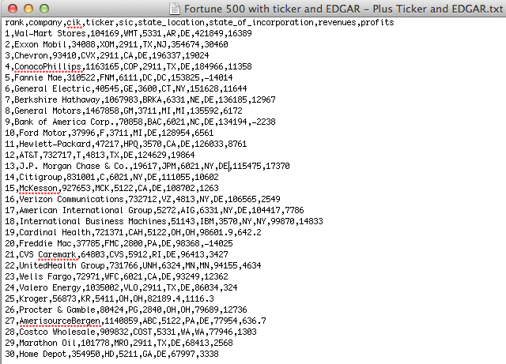
Tabular Data (csv)
Fortune 500

Slide 75
Protein Data Bank
HEADER APOPTOSIS 05-OCT-10 3IZA
TITLE STRUCTURE OF AN APOPTOSOME-PROCASPASE-9 CARD COMPLEX
COMPND MOL_ID: 1;
COMPND 2 MOLECULE: APOPTOTIC PROTEASE-ACTIVATING FACTOR 1;
COMPND 3 CHAIN: A, B, C, D, E, F, G;
COMPND 4 SYNONYM: APAF-1;
COMPND 5 ENGINEERED: YES
SOURCE MOL_ID: 1;
SOURCE 2 ORGANISM_SCIENTIFIC: HOMO SAPIENS;
SOURCE 3 ORGANISM_COMMON: HUMAN;
SOURCE 4 ORGANISM_TAXID: 9606;
SOURCE 5 GENE: APAF1, KIAA0413;
SOURCE 6 EXPRESSION_SYSTEM: SPODOPTERA FRUGIPERDA;
SOURCE 7 EXPRESSION_SYSTEM_TAXID: 7108;
SOURCE 8 EXPRESSION_SYSTEM_STRAIN: SF21;
SOURCE 9 EXPRESSION_SYSTEM_VECTOR_TYPE: INSECT VIRUS;
SOURCE 10 EXPRESSION_SYSTEM_PLASMID: PFASTBAC1
KEYWDS APOPTOSOME, APAF-1, PROCASPASE-9 CARD, APOPTOSIS
EXPDTA ELECTRON MICROSCOPY
AUTHOR S.YUAN,X.YU,M.TOPF,S.J.LUDTKE,X.WANG,C.W.AKEY
REVDAT 1 03-NOV-10 3IZA 0
SPRSDE 03-NOV-10 3IZA 3IYT
JRNL AUTH S.YUAN,X.YU,M.TOPF,S.J.LUDTKE,X.WANG,C.W.AKEY
JRNL TITL STRUCTURE OF AN APOPTOSOME-PROCASPASE-9 CARD COMPLEX
JRNL REF STRUCTURE V. 18 571 2010

Slide 76

Internet of Things: Example measurements
36m
33m: 111
32m: 110
30m: 109,108,107
20m: 106,105,104
10m: 103, 102, 101

Slide 77
Tabular Data from Sensors
Challenges
May be many missing fields (a particular sensor may not produce all types of output).
Device may go offline for a while.
Device may be damaged (permanently or intermittently).
Timestamps usually critical but may not be accurate.
Other meta-data (location, device ID) may have errors.

Slide 78
Log Files – Example Apache Web Log
Processes, usually daemons, create logs
e.g., httpd, mysqld, syslogd
66.249.65.107 - - [08/Oct/2007:04:54:20 -0400] "GET /support.html HTTP/1.1" 200 11179 "-" "Mozilla/5.0 (compatible; Googlebot/2.1; +http://www.google.com/bot.html)"
111.111.111.111 - - [08/Oct/2007:11:17:55 -0400] "GET / HTTP/1.1" 200 10801 "http://www.google.com/search?q=log+analyzer&ie=utf-8&oe=utf-8 &aq=t&rls=org.mozilla:en-US:official&client=firefox-a" "Mozilla/5.0 (Windows; U; Windows NT 5.2; en-US; rv:1.8.1.7) Gecko/20070914 Firefox/2.0.0.7"
111.111.111.111 - - [08/Oct/2007:11:17:55 -0400] "GET /style.css HTTP/1.1" 200 3225 “"http://www.loganalyzer.net/" "Mozilla/5.0 (Windows; U; Windows NT 5.2; en-US; rv:1.8.1.7) Gecko/20070914 Firefox/2.0.0.7"

Slide 79

Syslog – A Standard for System Messages
Developed by Eric Allman (at Berkeley) as part of the Sendmail project
Standardized by the IETF in RFC 3164 and RFC 5424
Listens on port 514 using UDP
Puts data in /var/log/messages by default
Enables rich analysis:

Slide 80
Syslog
dhcp-47-129:DataScienceF14> syslog -w 10
Feb 3 15:18:11 dhcp-47-129 Evernote[1140] <Warning>: -[EDAMAccounting read:]: unexpected field ID 23 with type 8. Skipping.
Feb 3 15:18:11 dhcp-47-129 Evernote[1140] <Warning>: -[EDAMUser read:]: unexpected field ID 17 with type 12. Skipping.
Feb 3 15:18:11 dhcp-47-129 Evernote[1140] <Warning>: -[EDAMAuthenticationResult read:]: unexpected field ID 6 with type 11. Skipping.
Feb 3 15:18:11 dhcp-47-129 Evernote[1140] <Warning>: -[EDAMAuthenticationResult read:]: unexpected field ID 7 with type 11. Skipping.
Feb 3 15:18:11 dhcp-47-129 Evernote[1140] <Warning>: -[EDAMAccounting read:]: unexpected field ID 19 with type 8. Skipping.
Feb 3 15:18:11 dhcp-47-129 Evernote[1140] <Warning>: -[EDAMAccounting read:]: unexpected field ID 23 with type 8. Skipping.
Feb 3 15:18:11 dhcp-47-129 Evernote[1140] <Warning>: -[EDAMUser read:]: unexpected field ID 17 with type 12. Skipping.
Feb 3 15:18:11 dhcp-47-129 Evernote[1140] <Warning>: -[EDAMSyncState read:]: unexpected field ID 5 with type 10. Skipping.
Feb 3 15:18:49 dhcp-47-129 com.apple.mtmd[47] <Notice>: low priority thinning needed for volume Macintosh HD (/) with 18.9 <= 20.0 pct free space

Slide 81
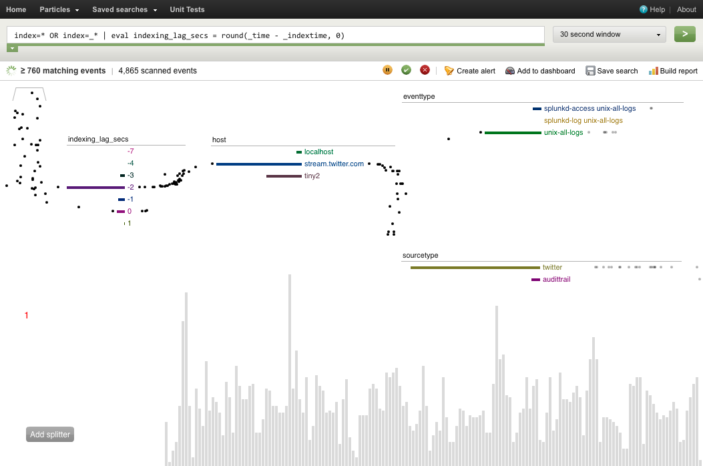
“Splunking”
Grab data from many machines
Index it
Check for unusual events:
Disk problems
Network congestion
Security attacks
Monitor Resources
Network
Memory usage
Disk use, latency
Threads
Dashboard for cloud administration.

Slide 82
Outline for this Evening
Some Ideas from Kandel et al. Paper
Data Types and Sources – “Document” data
Data Preparation and Manipulation
Files

Slide 83
Some Questions
1) How Many Characters are there in a Tweet?
2) How Many Bytes are there in a Tweet (msg)?

Slide 84
Tweet JSON Format

Slide 85
Tweet JSON Format
So how do we process the JSON from Twitter?
Stay tuned, but first some concepts from the XML world…

Slide 86
XML, DOM and SAX
<?xml version="1.0" encoding="UTF-8"?>
<!-- bookstore.xml -->
<bookstore>
<book ISBN="0123456001">
<title>Java For Dummies</title>
<author>Tan Ah Teck</author>
<category>Programming</category>
<year>2009</year>
<edition>7</edition>
<price>19.99</price>
</book>

Slide 87
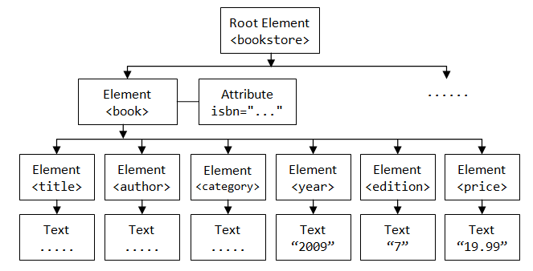
XML, DOM and SAX
XML is a text format that encodes DOM (Document-Object Models) which is a data structure e.g. for Web pages.
The DOM is tree-structured:

Slide 88
XML, DOM and SAX
The DOM is an easy object to work with: all the data in the object is accessible by links.
The problem is that I might not care about most of the data, and I might not be able to fit the DOM for a large object in RAM.

Slide 89
SAX
SAX (Simple API for XML) is an alternative “lightweight” way to process XML.
A SAX parser generates a stream of events as it parses the XML file. The programmer registers handlers for each one.
It allows a programmer to handle only parts of the data structure.

Slide 90
SAX
<?xml version="1.0" encoding="UTF-8"?>
<!-- bookstore.xml -->
<bookstore>
<book ISBN="0123456001">
<title>Java For Dummies</title>
<author>Tan Ah Teck</author>
<category>Programming</category>
<year>2009</year>
<edition>7</edition>
<price>19.99</price>
</book>
Document Header
Comment
Start-element “bookstore”
Start-element “book”
Start-element “title”
End-element “title”
End-element “book”

Slide 91
What about JSON?
Most JSON parsers construct the “DOM” directly.
But there are a few SAX-style parsers:
Jackson
JSON-simple

Slide 92
What about HTML?
Common Crawl, about 5 billion web pages, between 0.2-0.5% of Google’s web crawl.
60 TB, hosted on Amazon S3, also available for download.
Includes link data, page rank.
In ARC (Internet Archive) File format.
So there’s plenty of data, and there are many crawlers for targeted exploration…
HTTrack, …

Slide 93
HTML Tag Soup
<!DOCTYPE html PUBLIC "-//W3C//DTD XHTML 1.0 Transitional//EN" "http://www.w3.org/TR/xhtml1/DTD/xhtml1-transitional.dtd">
<html xmlns="http://www.w3.org/1999/xhtml">
<head><!-- types/widgets/pages/common/page.tmpl home/index_v3.html generated by index_v3 on Wed 29 Feb 2012 11:04:41 PM PST -->
<title>San Francisco Bay Area &mdash; News, Sports, Business, Entertainment, Classifieds: SFGate</title>
<meta http-equiv="content-type" content="text/html; charset=iso-8859-1" />
<meta name="description" content="Find local news &amp; information, updated weather, traffic, classifieds, sports scores, real estate, jobs, cars, food &amp; wine, travel, entertainment, events and more on SFGate.com. Connect to the Bay Area community." />
<meta name="keywords" content="San Francisco, San Francisco Bay Area, news, local events, breaking news, world news, San Francisco Chronicle, SFGate" />
<meta property="fb:page_id" content="105702905593" />
<meta property="fb:admins" content="653226748,658759748" />
<!-- /widgets/sitewide/css/all/inc.html widgets/pages/common/post_write_mtime/css_inc.tmpl -->
<!-- generated by sitewidecss on Thu 16 Feb 2012 10:41:53 AM PST -->
<link rel="stylesheet" type="text/css" title="SFGate" media="all" href="http://imgs.sfgate.com/css1329417713/sitewide/css/sitewide.css" />
<!-- sitewide/css/all/inc.html end css_inc.tmpl -->

Slide 94
HTML Tools - Parsing
“Beautiful Soup” http://www.crummy.com/software/BeautifulSoup/ a Python API for handling real HTML. DOM or SAX interfaces.
“TagSoup” http://ccil.org/~cowan/XML/tagsoup/ provides a Sax interface, i.e. a streaming parse, to Java applications. Can transform to a format you want using XSLT.
Taggle, part of the Arabica toolset http://www.jezuk.co.uk/cgi-bin/view/arabica/code is a version of TagSoup written in C++. You probably want to use this if you have a lot of data.

Slide 95
Web Services
Most large web sites today actively discourage screen-scraping to get their content, and provide Web Service APIs instead.
This is the “right” way to get data from online sources.

Slide 96
Web Services
W3C definition:
a "Web service" as "a software system designed to support interoperable machine-to-machine interaction over a network".
Two kinds:
XML-based RPC-style messages: WSDL and SOAP
REST-style stateless interactions, URLs encode state
Can run over different transports, but usually HTTP

Slide 97
Examples
Twitter: REST API and streaming API with JSON content. Provides sampling, searching and filtering capabilities.
Amazon: has a “product advertising API” in XML with a WSDL spec. Includes product search, reviews etc.
Livejournal: RSS/Atom + custom XML/RPC. Search by keyword, topic, follow friend links.
Netflix: Javascript, Atom and REST interfaces.
Ebay: Many APIs for searching, buying and posting. WSDL descriptions, client code in Java and .NET
Flickr: Comprehensive API set, free for non-commercial use. REST, XML-RPC, SOAP, with client code in many languages.
vBulletin: REST interface, most actions supported

Slide 98
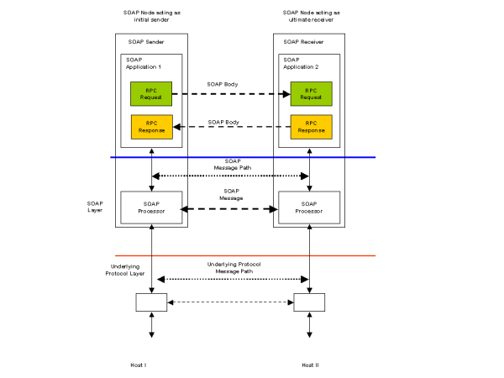
Web Services
XML-RPC, requires a request-response cycle. Often longer “conversations.”

Slide 99
WSDL and SOAP
Conceptually a Remote-Procedure-Call system, like CORBA, Java RMI etc.
But RPC often has to pass through multiple layers of firewalls, causing many problems as security increased in the 1990s.
Web services typically use HTTP as a transport, which runs almost anywhere, provides security and simple GET-POST methods. So HTTP-based RPC was a natural choice.
SOAP uses XML messages, is human-readable, easy to process from any programming language, and relatively robust to version slippage.

Slide 100
SOAP is
SOAP covers the following four main areas:
A message format for one-way communication describing how a message can be packed into an XML document.
A description of how a SOAP message should be transported using HTTP (for Web-based interaction) or SMTP (for e-mail-based interaction).
A set of rules that must be followed when processing a SOAP message and a simple classification of the entities involved in processing a SOAP message.
A set of conventions on how to turn an RPC call into a SOAP message and back.

Slide 101
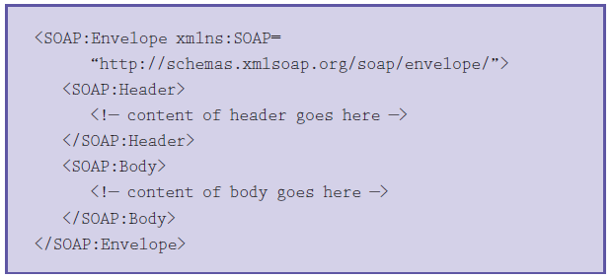
Soap Message
Typically an XML element containing header and body elements

Slide 102
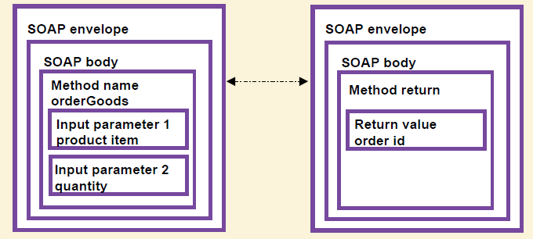
SOAP RPC
SOAP RPC messages typically encode arguments that are presented to the calling program as parameters and return values:

Slide 103
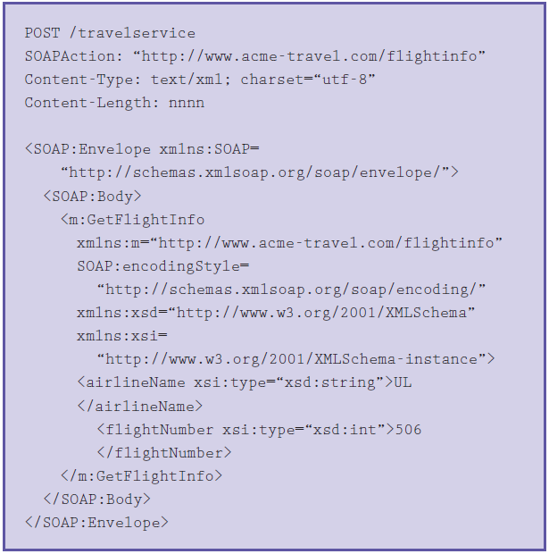
Soap RPC

Slide 104
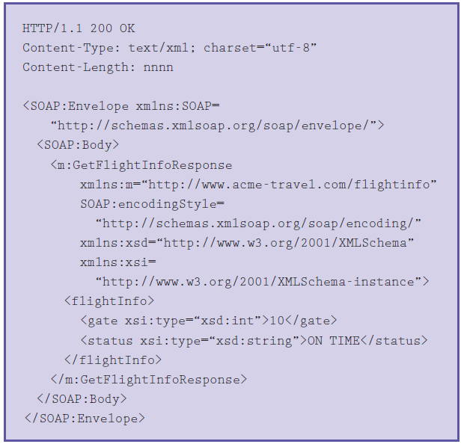
Soap Response

Slide 105
REST
REpresentation State Transfer
Stateless Client/Server Protocol: Principles
Each message in the protocol contains all the information needed by the receiver to understand and/or process it. This constraint attempts to “keep things simple” and avoid needless complexity
Set of Uniquely Addressable Resources
“Everything is a Resource” in a RESTful system
Requires universal syntax for resource identification (e.g. URI)

Slide 106
REST
Set of Well-Defined Operations that can be applied to all resources
In context of HTTP, the primary methods are
POST, GET, PUT, DELETE
these are similar (but not exactly) to the database notion of
CRUD (Create, Read, Update, Delete)
The use of Hypermedia both for Application Information and State Transitions
Resources are typically stored in a structured data format that supports hypermedia links, such as XHTML or XML

Slide 107
REST example
<user>
<name>Jane</name>
<gender>female</gender>
<location href="http://www.example.org/us/ny/new_york">
New York City, NY, USA</location>
</user>
This documentation is a representation used for the User resource
It might live at http://www.example.org/users/jane/
If a user needs information about Jane, they GET this resource
If they need to modify it, they GET it, modify it, and PUT it back
The href to the Location resource allows savvy clients to gain access to its information with another simple GET request
Implication: Clients cannot be “thin”; need to understand resource formats

Slide 108
REST vs. RPC
In RPC systems, the design emphasis is on verbs
What operations can I invoke on a system?
getUser(), addUser(), removeUser(), updateUser(), getLocation(), updateLocation(), listUsers(), listLocations(), etc.
In REST systems, the design emphasis is on nouns
User, Location
In REST, you would define XML representations for these resources and then apply the standard methods to them

Slide 109
Outline for this Evening
Some Ideas from Kandel et al. Paper
Data Types and Sources
Data Preparation and Manipulation
Files

Slide 110

Files
What is a file?
A file is a named sequence of bytes
Typically stored as a collection of pages (or blocks)
A filesystem is a collection of files organized within an hierarchical namespace
Responsible for laying out those bytes on physical media
Stores file metadata
Provides an API for interaction with files
Standard operations
open()/close()
seek()
read()/write()

Slide 111
Files
Hierarchical namespace
/ is known as the root of a filesystem
On Linux, the Filesystem Hierarchy Standard specifies which files live where
System executables in /usr/bin
Log files in /var/log
Permissions can be applied to all files beneath a directory
Files are not always arranged in a hierarchical namespace
Content-addressable storage (CAS)
Often used for large multimedia collections

Slide 112
File Formats
Considerations for a file format
Data model: tabular, hierarchical, array
Physical layout
Field units and validation
Metadata: header, side file, specification, other?
Plain text or binary
Encoding: ASCII, UTF-8, other?
Delimiters and escaping
Compression, encryption, checksums?
Schema evolution

Slide 113
File Performance
Read/Write time (180 MB tabular file)
 | Read Time (Text) | Write Time (Text) | Read Time (Binary) | Write Time (Binary)
Pandas (Python) | 88 secs | 107 secs | ** | **
Scala/Java | 12 secs | 30 secs | 0.5-2* secs | 0.5-2* secs
** Pandas doesn’t have a default binary file I/O library – you can use Python, but performance depends on what you pick.
* 2 seconds is the time for sustainable read/write. May be faster due to caching

Slide 114
File Performance - Compression
Read/Write time (180 MB tabular file, Scala/Java)
Binary File | Read Time | Write Time | File Size
Gzip level 6 (Java default) | 1-2 secs | 11 secs | 35 MB
Gzip level 3 | 1-2 secs | 4 secs | 37 MB
Gzip level 1 | 1-2 secs | 2 secs | 38 MB
LZ4 fast | 1-2 secs | 1-2 secs | 63 MB
Text File | Read Time | Write Time | File Size
Gzip level 6 (default) | 1-2 secs | 22 secs | 32 MB
Gzip level 3 | 1-2 secs | 14 secs | 35 MB
Gzip level 1 | 1-2 secs | 12 secs | 39 MB
LZ4 fast | 1-2 secs | 11 secs | 63 MB

